Slide 1
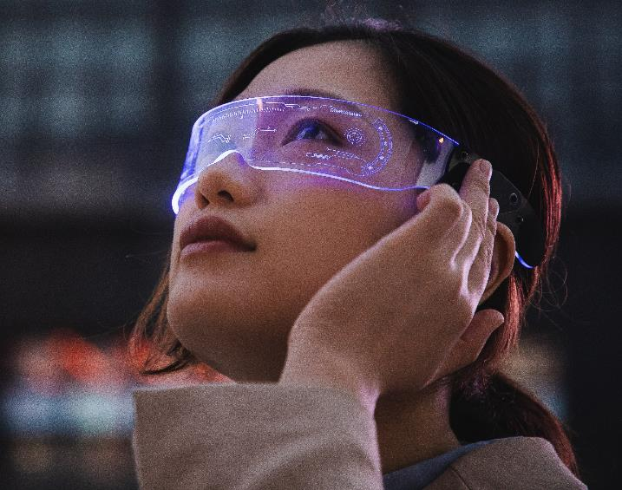
RAG FUSION with Cohere & WEAVIATE
Csaba Toth
ThruThink Support Chat Agent

Slide 2

Csaba Toth
Full stack engineer
Director of Product Engineering at SportsBoard (startup)
CTO at ThruThink (startup)
Interested in AR/XR, AI/ML, lately Gen AI, LLM, RAG
GDG (Google Developer Group) Fresno lead, WTM (Women Techmakers) Fresno ambassador, tech meetup junkie

Slide 3

THRUTHINK
ThruThink® is a business budgeting on-line app to create professional budgets and forecasts
product of literally decades of experience and careful thought, and thousands of calculations
Thru-hiking, or through-hiking, is the act of hiking an established long-distance trail end-to-end continuously
There are no dedicated personnel for support chat agent roles, had a “classic” chat agent integration

Slide 4

SUPPORT CHAT AGENT
Invaluable help, given that
It stays relatively grounded
Won’t hallucinate* wildly
Desired abilities:
Main goal: answer ThruThink software specific questions: “In ThruThink can I make adjustments on the Cash Flow Control page?”
Nice to have: answer more generic questions such as: “How much inventory should I have?”

Slide 5
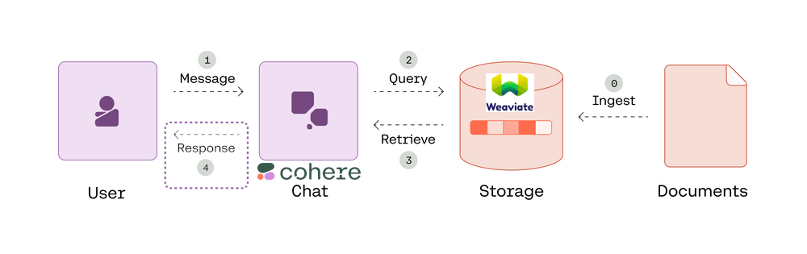
Traditional RAG

Slide 6
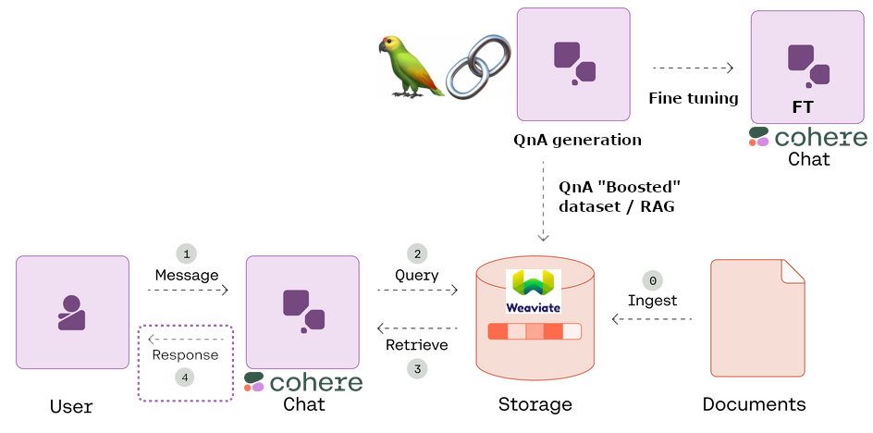
QnA BOOSTED RAG

Slide 7
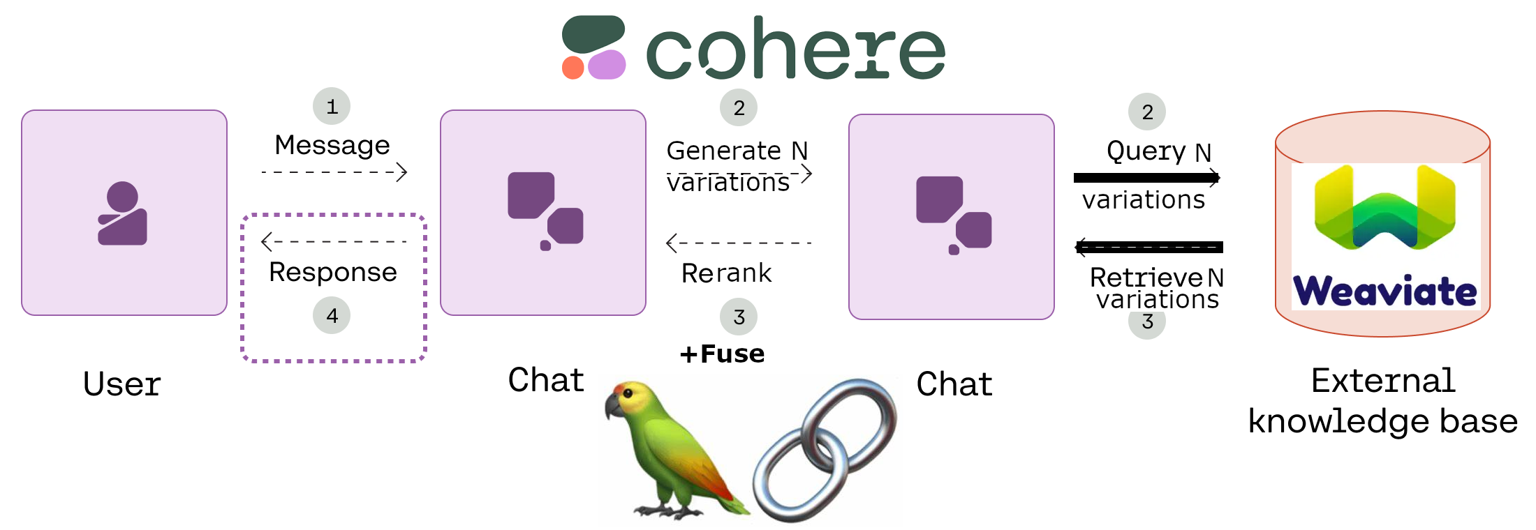
RAG FUSION

Slide 8
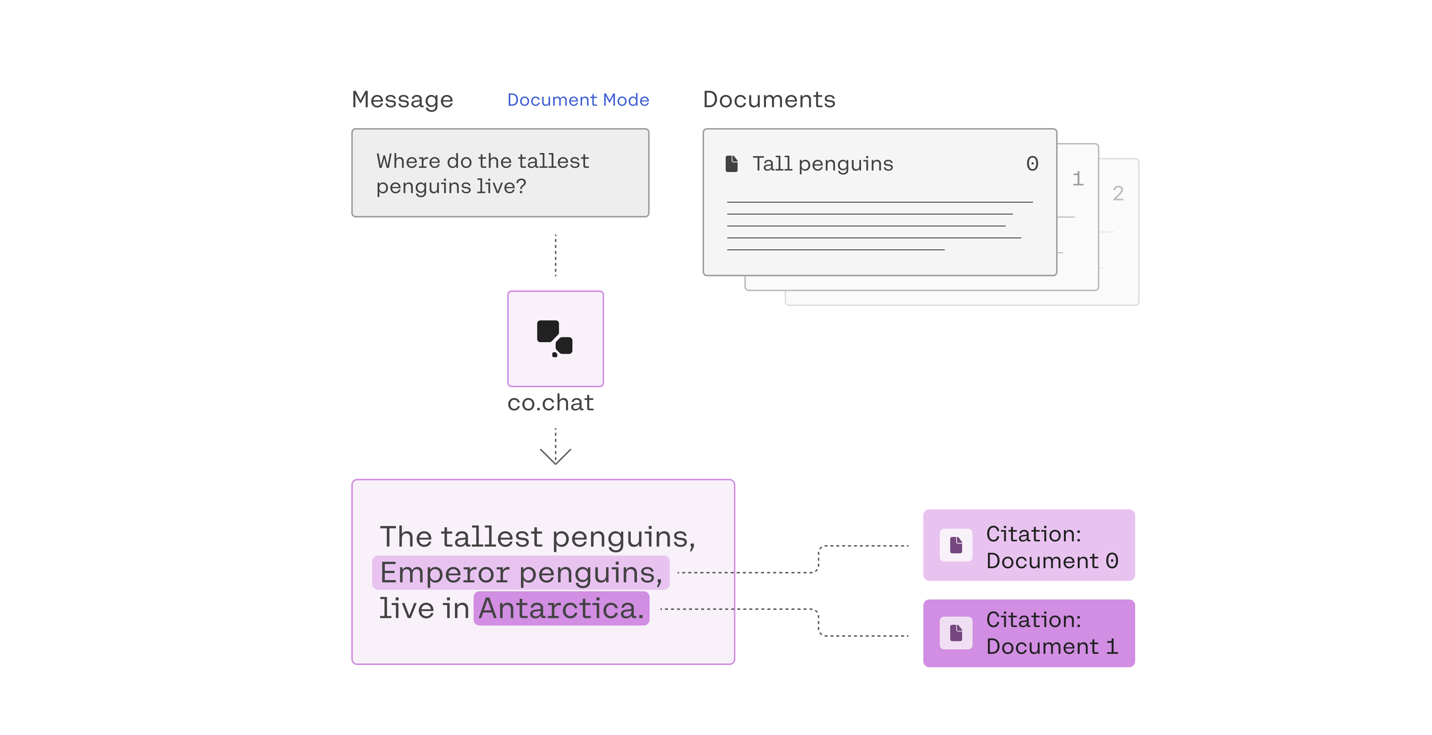
STEP 4 pt1: DOCUMENT MODE

Slide 9
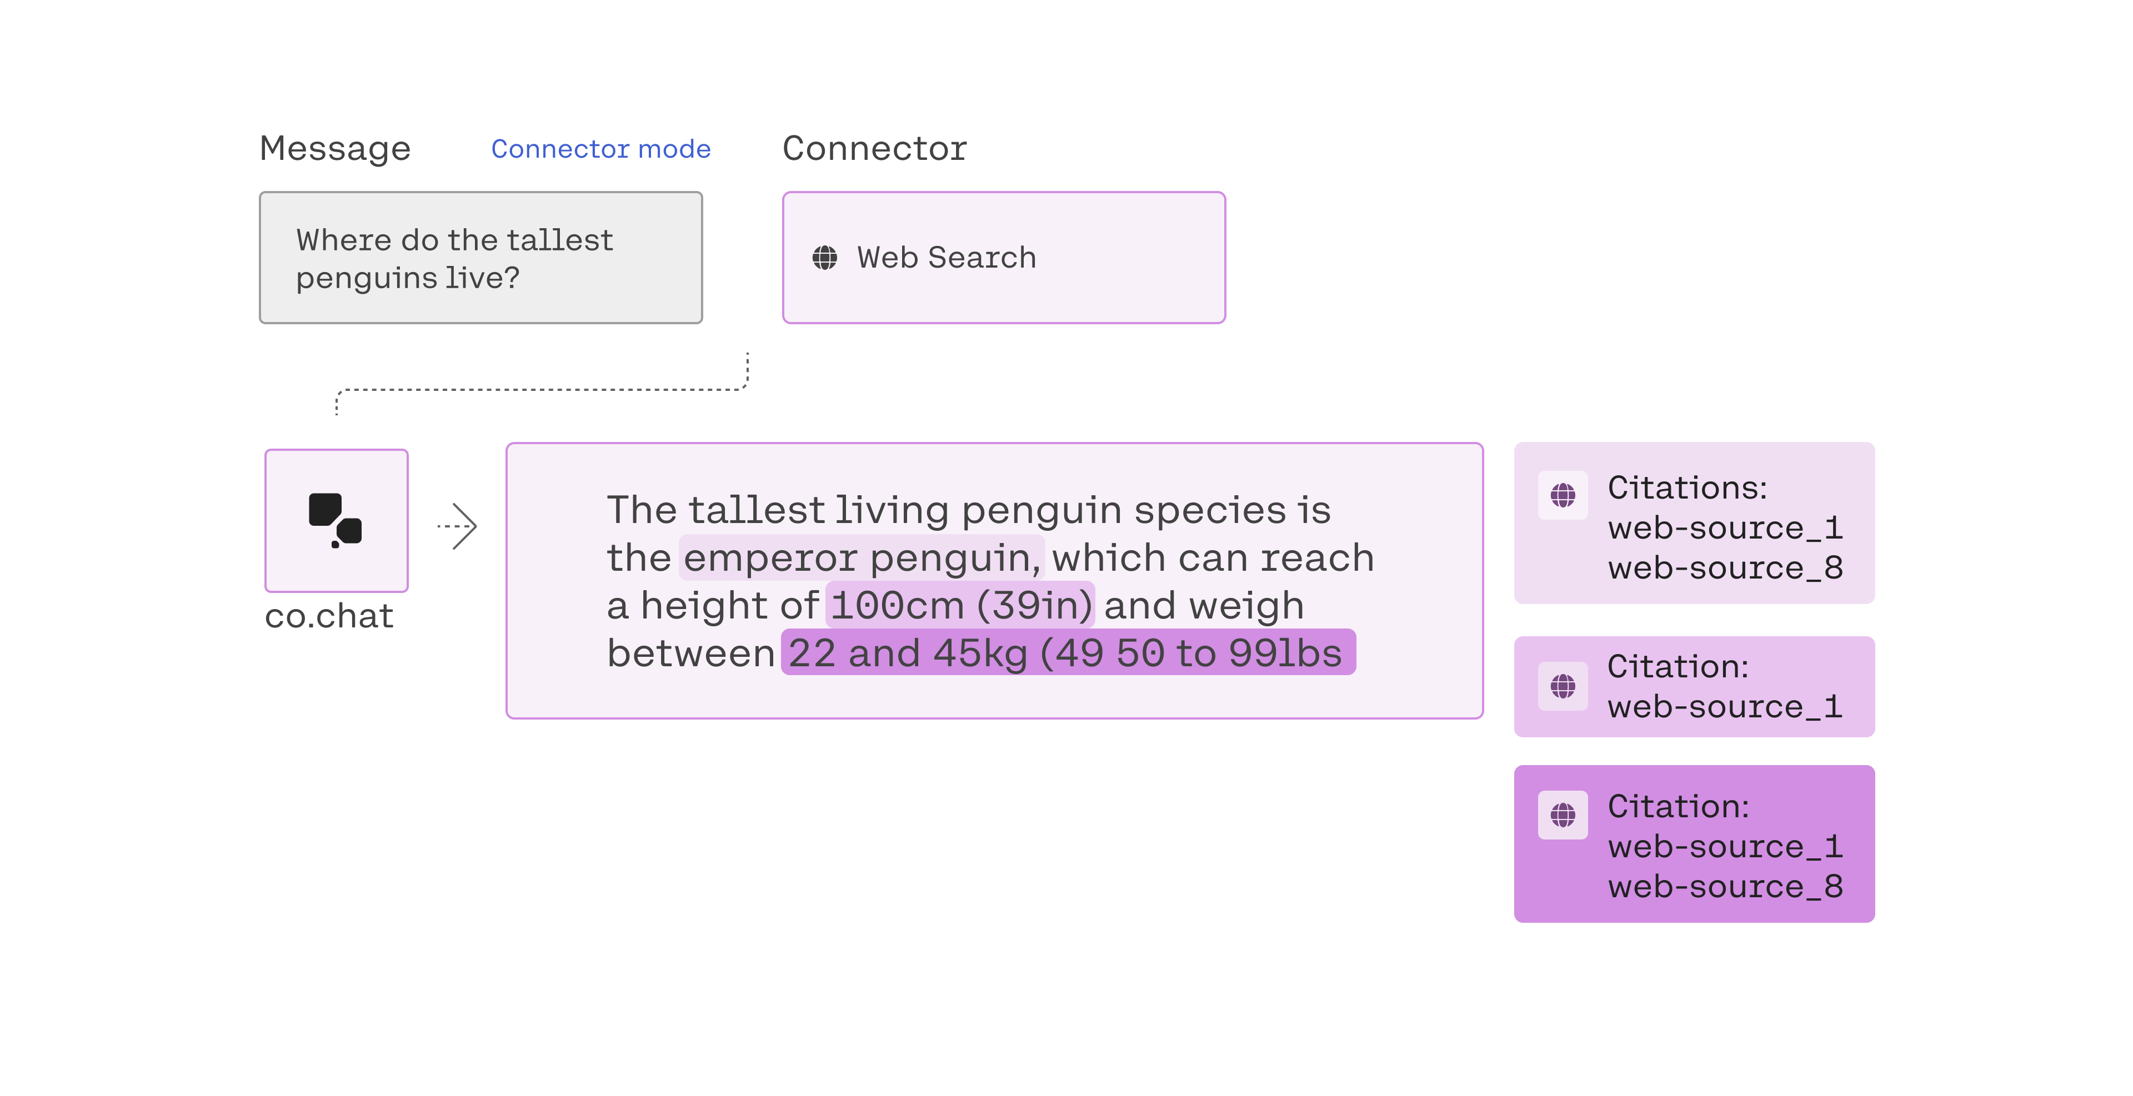
STEP 4 pt2: CONNECTOR MODE

Slide 10

Accomplishments
Contributed to question_extractor for the QnA generation, and QnA reprocessing for ingestion
Check-pointing to resume generation
Cohere fine tuning format
Rate limiting
https://github.com/CsabaConsulting/question_extractor
QBRAG with the synthetic / augmented data

Slide 11
ACCOMPLISMENTS
RAG FUSION
Using LangChain, Weaviate, Cohere
STREAMLIT
Serving platform is streamlit, highly customized and advanced UI with references
https://github.com/CsabaConsulting/ThruThinkCohereWeaviateChat
Notebooks
https://github.com/CsabaConsulting/Cohere

Slide 12

Co.CHAT
Document mode
Web connector mode
Several advanced capabilities such as built-in conversation management

Slide 13

Future / TO-DO
UX/UI​
Performance / quality​
Decrease runtime by running the variation document retrievals in parallel, this is a Streamlit specific tech challenge with asyncio / await.
Decrease runtime by running the final two co.chat RAG calls in parallel, this is a Streamlit specific tech challenge with asyncio / await.
Make the citation linking nicer and other UI enhancements.
Measure how much the RAG Fusion improves answer quality.
Measure the trade-off factoring in extra latency and potential token usage increase which also means cost increase.
Integrate the agent into ThruThink which uses ASP.NET MVC / C# / Azure technology stack. I'll be able to open up referred help topics using the meta-data.
Add filter against harmful content, for example using Google PaLM2's safety attributes.

Slide 14

Thank you
Csaba Toth
https://csaba.page/
https://www.linkedin.com/in/csabatothdev

